Slide 1
Music Artist Clustering
By: Ryan Fisher
2/27/21

Slide 2
Introduction
Problem Statement
Have you ever heard an artist you liked and wanted to hear more artists that have a similar sound? You don’t want artists that are just in the same genre, you want artists that sound the same.
Goal
Using a data driven analysis and machine learning modeling techniques, we will hopefully be able to group artists by audio features and then recommend an artist that has a similar sound. I will combine

Slide 3
Data Acquisition
The data comes from Kaggle with data for more than 175,000 songs.
The dataset is updated monthly and was last updated at the end of January 2021.
Contains five csv files grouped by artist, genre, and year

Slide 4

Data Acquisition
Music Track Data - “data.csv”
This file contains numerical features for different audio characteristics for each song.
Danceability
Energy
Duration in MS
Instrumentalness
Valence
Popularity
Tempo
Liveness
Loudness
Speechiness
Year
Mode
Explicit
Key
Artists
Release Date
Name
Acousticness

Slide 5
Data Acquisition
Artist Data - “data_by_artist.csv”
Same features as track file, except it is grouped by artist.
Since we are most interested in clustering the data by artist, we will primarily use the data by artist file.
Each row in the file contains a different artist and each column is the audio feature from the data file.
There is an additional field called count. This field contains the number of songs in the main data file.

Slide 6
Data Wrangling
Artist data file was loaded into a dataframe using Pandas, called df
The file had zero NULL values
There were also zero duplicate values
This file was very clean and did not require any extra data wrangling

Slide 7
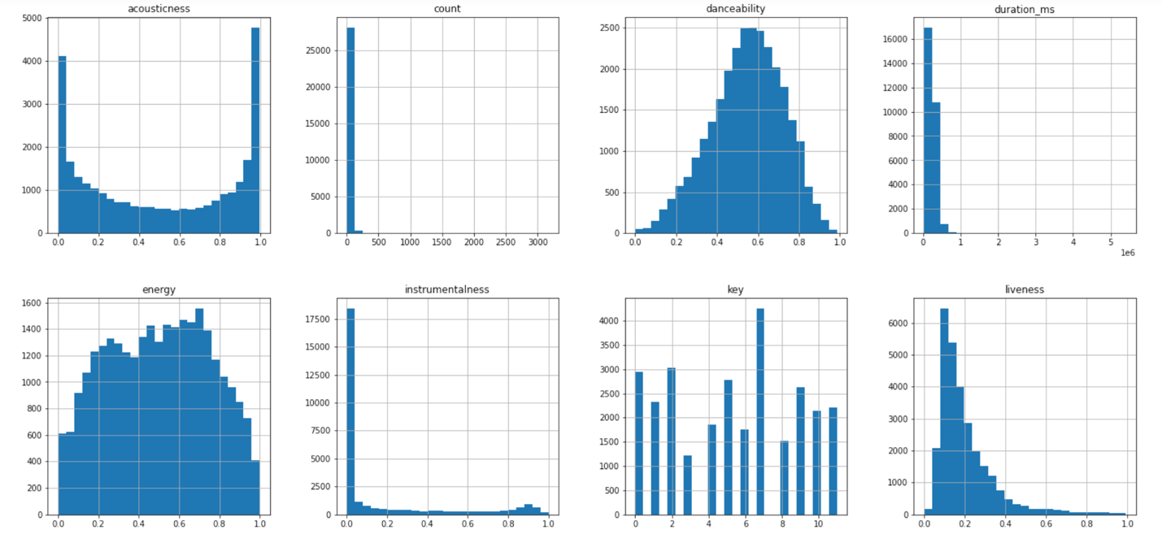
EDA - Distribution
Distribution of the data did not seem concerning

Slide 8
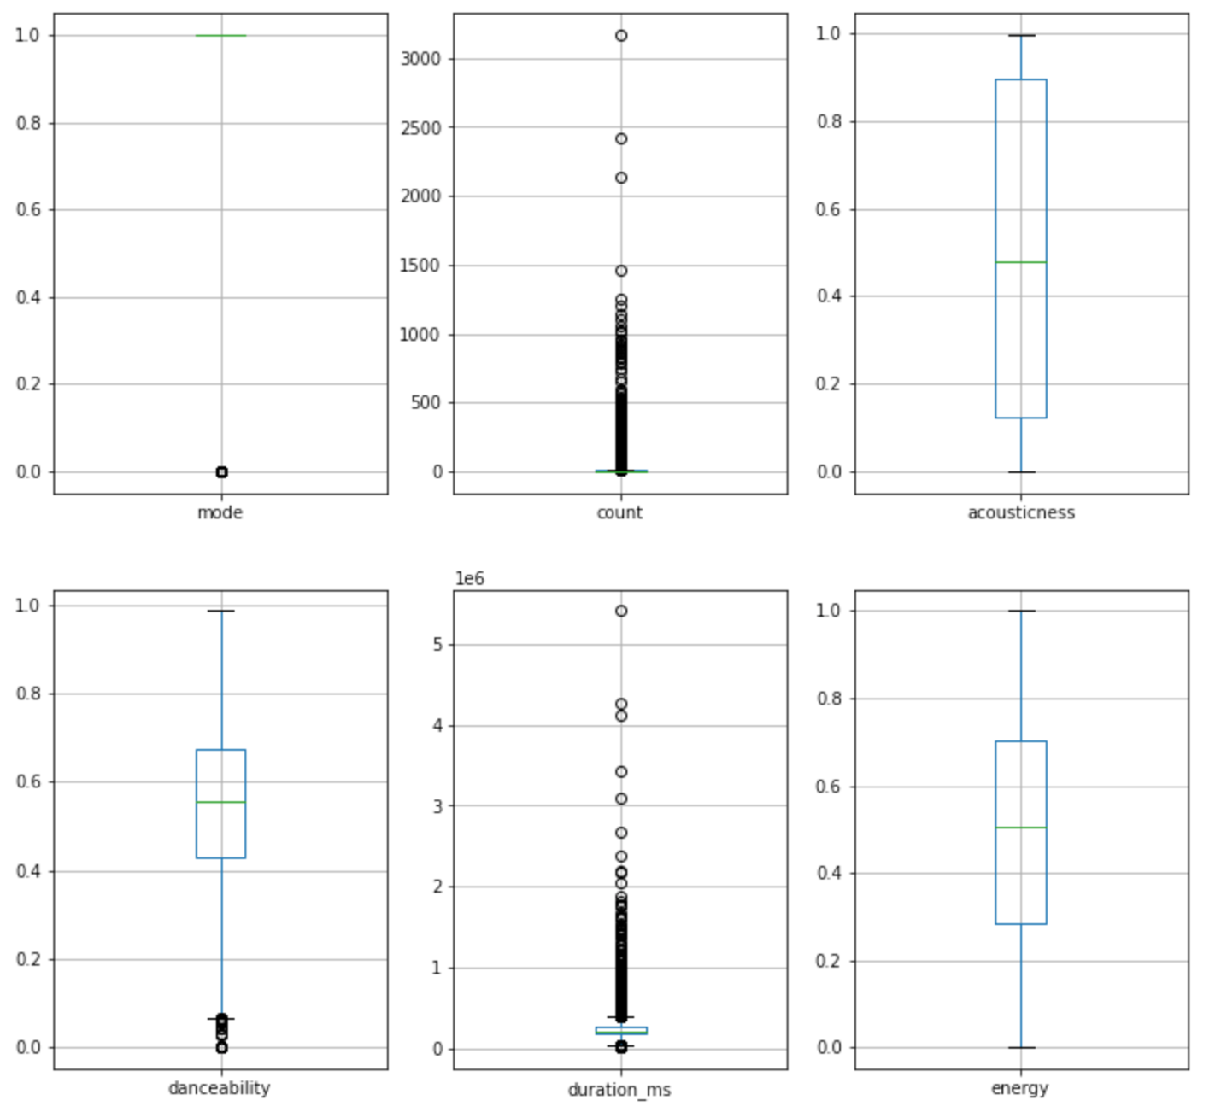
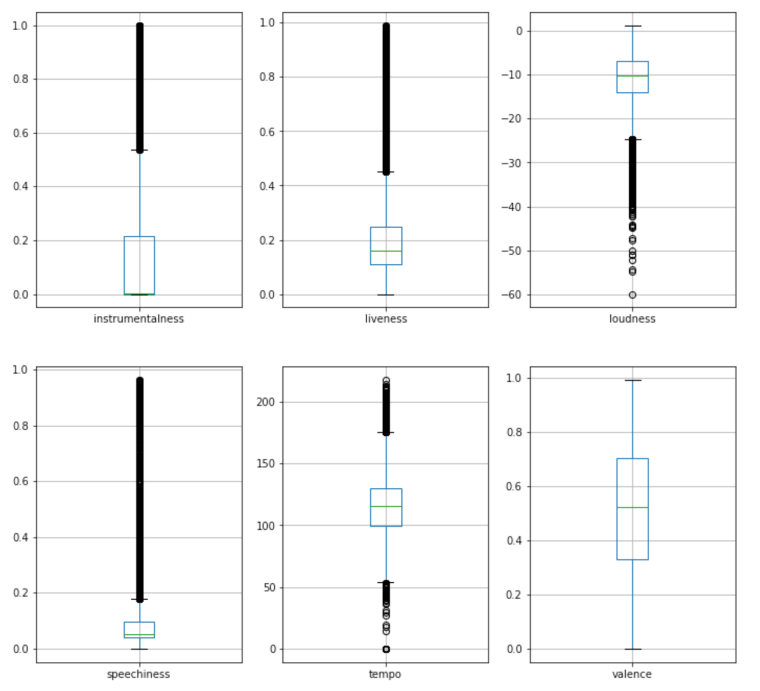
EDA - Outliers
There were some outliers but nothing that was concerning.
The only thing that stood out was the duration feature, but since this is the total duration for songs, and some artists may have many more songs than other artists, it didn’t seem to concerning.

Slide 9
Baseline Modeling – Preprocessing
I will be using two clustering models
Kmeans
Agglomerative
Created a new dataframe called df2.
Containing the artist data with the mode, count, and artists features removed.
Values from df2 were stored into X and ran the Standard Scaler on the data.

Slide 10
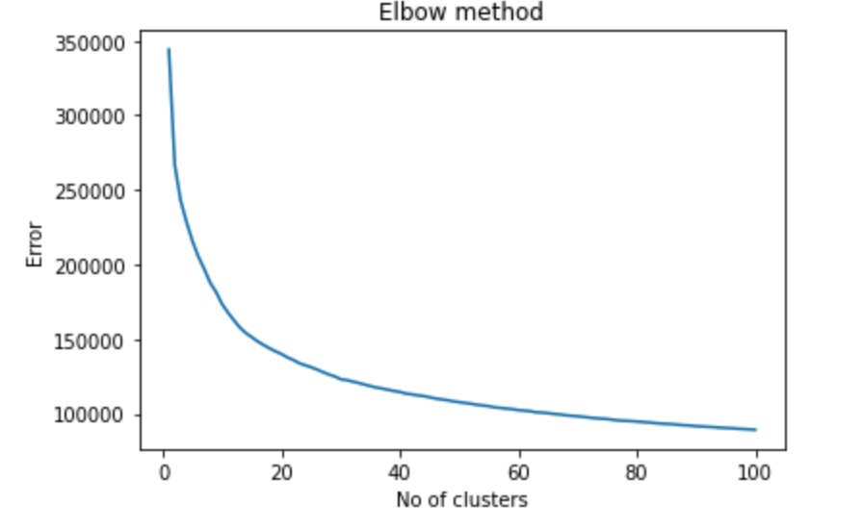
Baseline Modeling – Preprocessing
An elbow plot was created to see what would be the best number of clusters between 1 and 100.
Plot showed that the number of clusters should be around 20-40.
Chose 25 so that it was closer to the steeper part of the elbow but would allow a good number of clusters for recommending artists.

Slide 11
Baseline Modeling – Preprocessing
Artists that would most likely be clustered together were used as test cases:
50 – Cent
Eminem
Taylor Swift
Backstreet Boys
NSync
Bee Gees
The Beatles

Slide 12
Modeling
Data was fit and predicted, and a new feature called cluster was created that contains the cluster the artist was assigned to.
After clustering I checked the data to see what clusters each of my test cases were in
Some artists were grouped as expected, but some weren’t.
Test cases didn’t have similar musical sound characteristics.
Artist | KMeans Cluster
50 – Cent | 11
Eminem | 11
Taylor Swift | 9
Backstreet Boys | 21
NSync | 9
Bee Gees | 5
The Beatles | 5

Slide 13
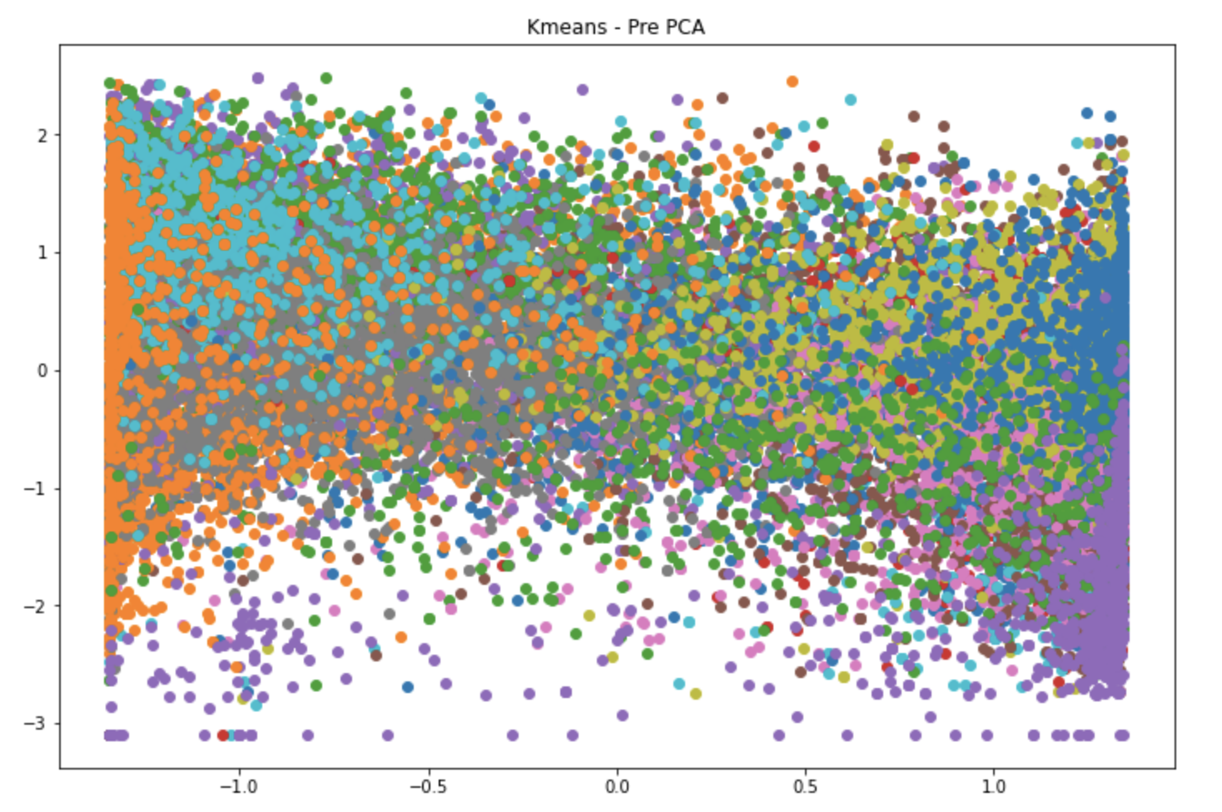
Extended Modeling
Both models were visualized to see the clusters of the data.
Clusters can’t be identified without doing PCA

Slide 14
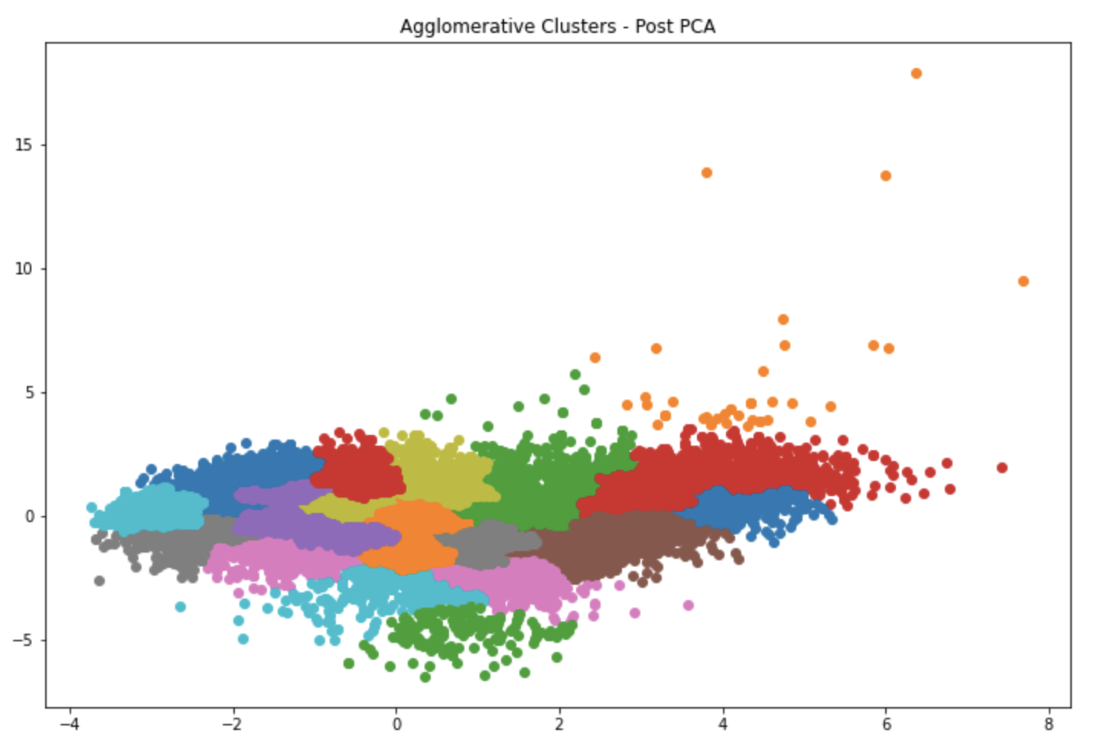
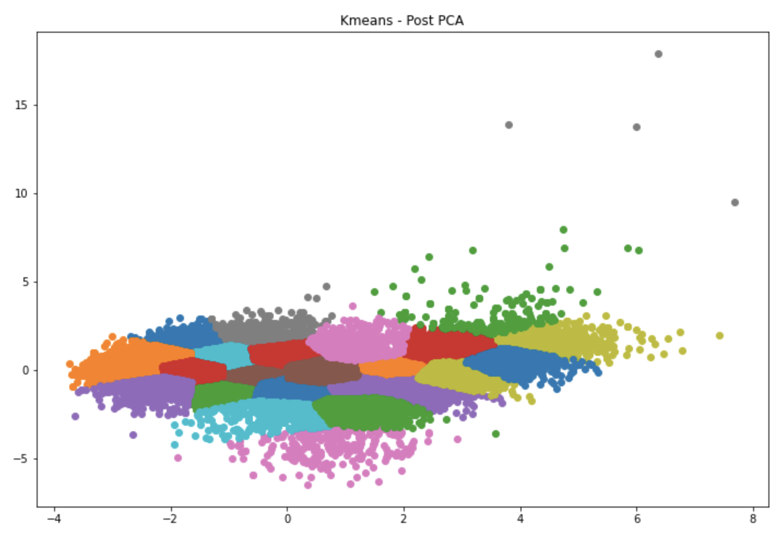
Extended Modeling – PCA Cluster Plots
Post PCA visualizations look significantly better.
This is due to reducing the features down to just two.
The comparison between Agglomerative and KMeans is very similar.
Some clusters in the Agglomerative scatter plot are broken out into smaller clusters of data when compared to the KMeans visualization, but the KMeans look more defined.

Slide 15
Extended Modeling – Euclidean Distance
Taylor Swift and the Backstreet Boys are in the same cluster
Nsync is not in the same cluster as the Backstreet Boys as expected
Looking at the Euclidean distance, Backstreet Boys are actually closer to Nsync than they are to Taylor Swift
Artist | Cluster | Euclidean Distance to NSync
NSync | 9 | -
Taylor Swift | 9 | 0.504
Backstreet Boys | 21 | 0.392

Slide 16
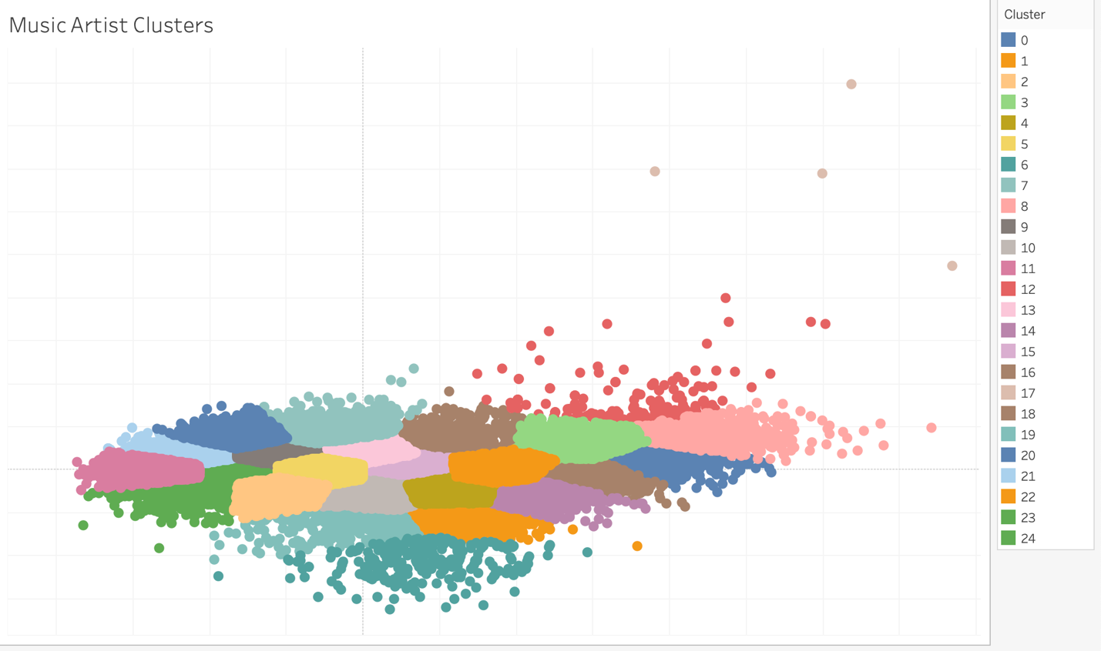
Final Visualization
KMeans PCA data loaded into Tableau and an interactive cluster plot was created to be able to visualize the artists when hovering over each point.
Plot was focused on most of the data so that it was more visually appealing.
Below is a screenshot, but please click on the link above for a more interactive experience.
While exploring this plot, a lot of comedians are clustered in the lower left portion of the plot (clusters 6 and 19). This also confirms that our clustering is accurate.

